Slide 1

MACHINE INTELLIGENCE Building a predictive model to predict the likelihood of a customer churning
- S M SUTHARSAN RAJ

Slide 2
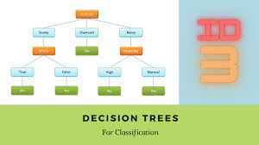
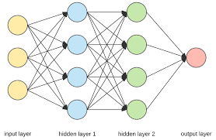
ABSTRACT
This assignment is about the customer churn prediction where the customers who purchased items from between 1st Dec 2010 to 31st Aug 2011 did not make any subsequent purchase in the period Sep 2011 to Dec 2011. Such customers are named as churn. The other customers who made the purchase are labelled as not churn. So this kind of labelling approach is taken care by the ID3 decision tree where we classify the customers based on the above 2 labels. Basically we create a target variable of taking customers in the above date range and then apply the classification algorithm.
Also we create a customer level features such as displaying the product names which is very much relevant for the customers. In addition we display the country code of the products and various statistical features for the customers.
Later we plot the ID3 tree for classification of Churn and Not Churn.
Finally we give the accuracy and classification report including the Confusion matrix, accuracy, etc…
In addition we do the classification using SVM, ANN and display the accuracy and classification report for the same.
Hence, by this we even constructed the comparative table for ID3, SVM and ANN.

Slide 3
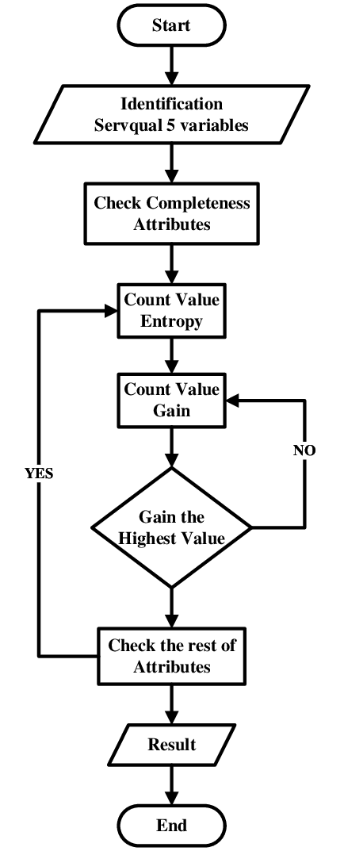
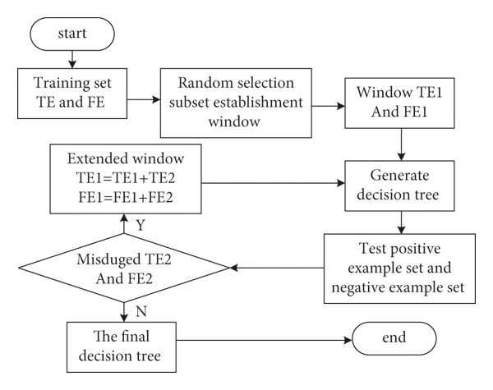
FLOWCHART-ID3
THE ID3 FLOWCHART

Slide 4
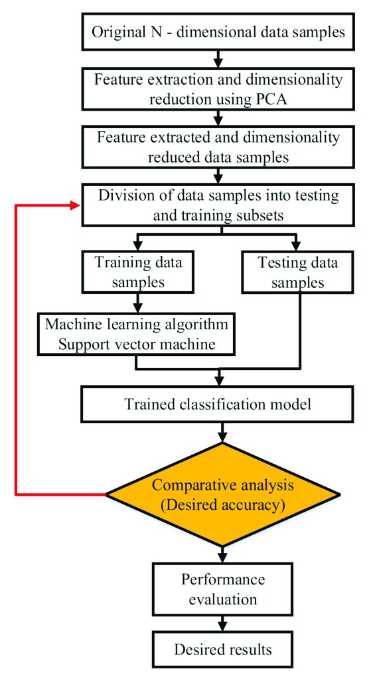
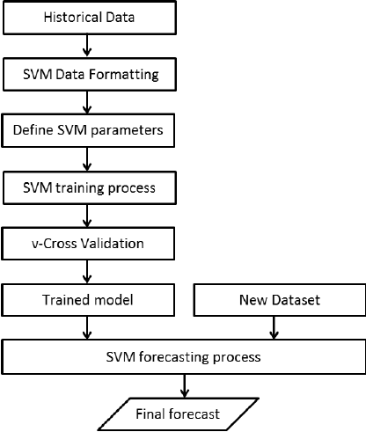
FLOWCHART-SVM
THE SVM FLOWCHART

Slide 5
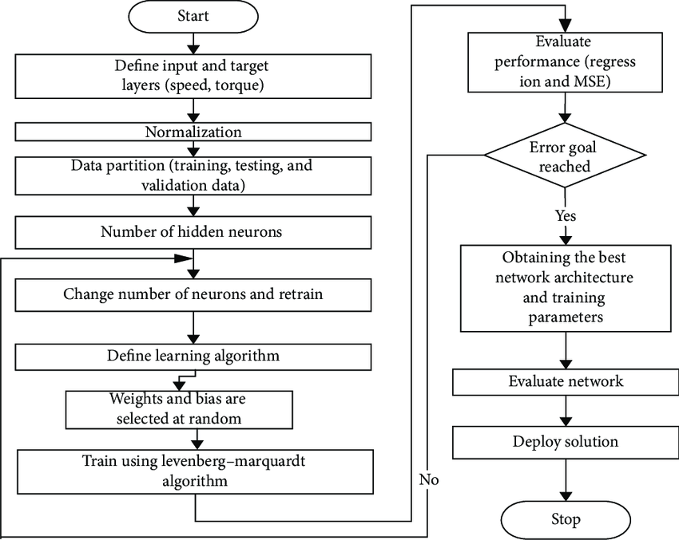
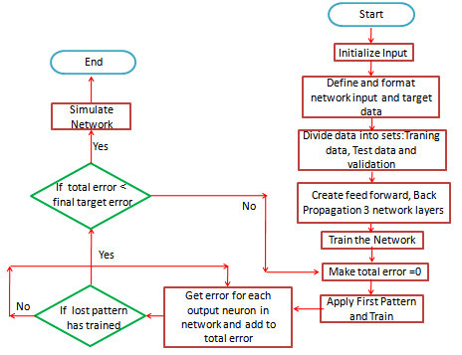
FLOWCHART-ANN

Slide 6
PYTHON PACKAGES USED
# FOR SVM
from sklearn.svm import SVC
from sklearn import svm
from sklearn.svm import LinearSVC
from sklearn.pipeline import Pipeline
# FOR ANN
from sklearn.neural_network import MLPClassifier
# FOR THE STATISTICS IN EACH MODEL
from sklearn.metrics import confusion_matrix
from sklearn.metrics import classification_report
from sklearn.metrics import roc_auc_score
from sklearn.metrics import roc_curve
from sklearn.model_selection import train_test_split
from sklearn import metrics
import warnings
warnings.filterwarnings('ignore')
%matplotlib inline
# GENERAL LIBRARIES FOR DATASET
import numpy as np
import matplotlib.pyplot as plt
import pandas as pd
import seaborn as sns
import datetime as dt
import math
# FOR ID3 DECISION TREE
from sklearn.preprocessing import StandardScaler
from sklearn import tree
from sklearn.tree import DecisionTreeClassifier
from numpy import log2 as log

Slide 7
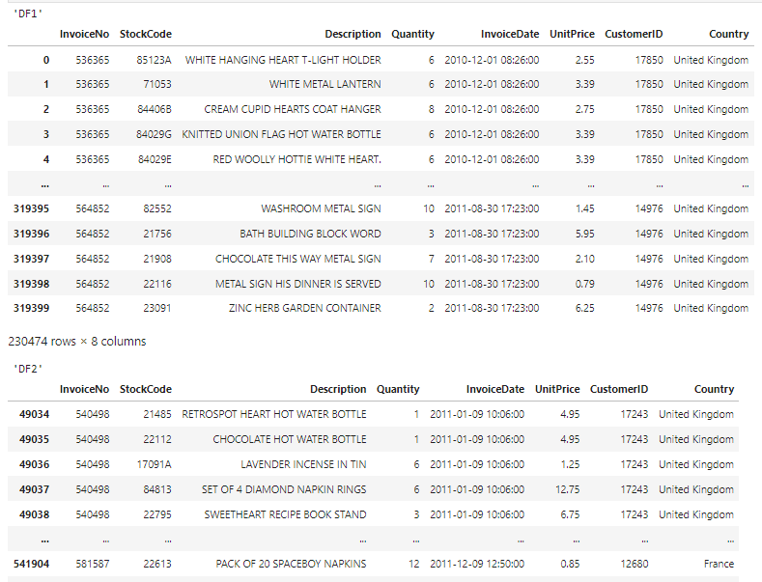
OUTPUT SCREENSHOTS
The 2 dataframes DF1 and DF2 representing the given ranges where the customers who purchased items from between 1st Dec 2010 to 31st Aug 2011 did made subsequent purchase in the period Sep 2011 to Dec 2011.

Slide 8
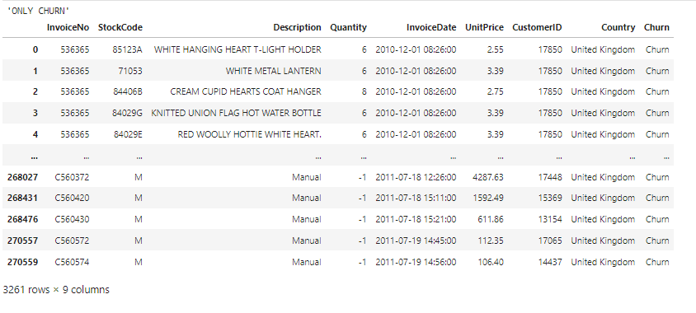
OUTPUT SCREENSHOTS
Target variable creation for the customers who are only labelled as churn.

Slide 9
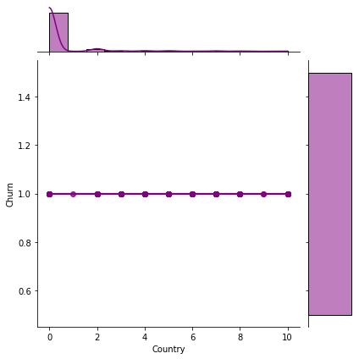
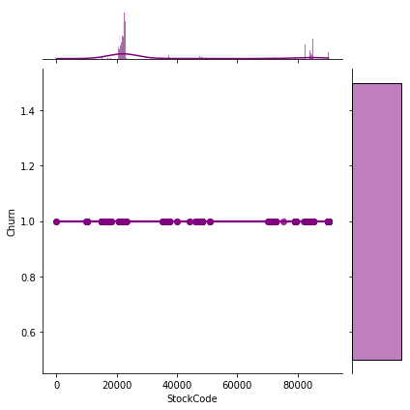
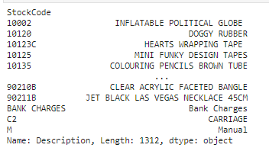

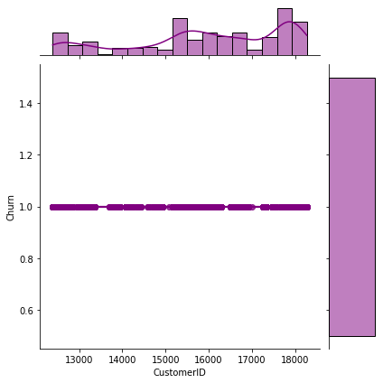

OUTPUT SCREENSHOTS

Slide 10
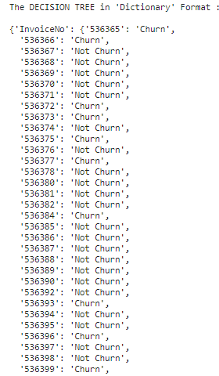
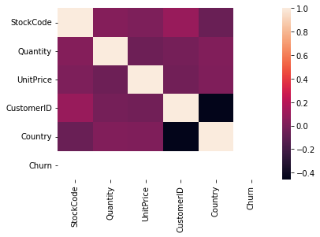
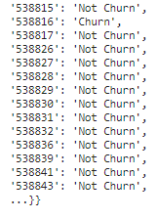
OUTPUT SCREENSHOTS
The decision tree using ID3 algorithm.
Output in dictionary format.
This heat map and the above slide represent the different customer level features

Slide 11
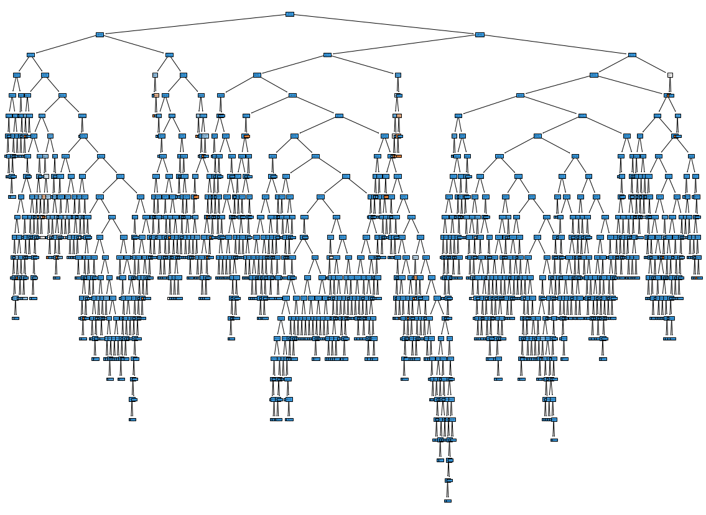
OUTPUT SCREENSHOTS
The plotting of the ID3 decision tree, representing the complete classification.

Slide 12
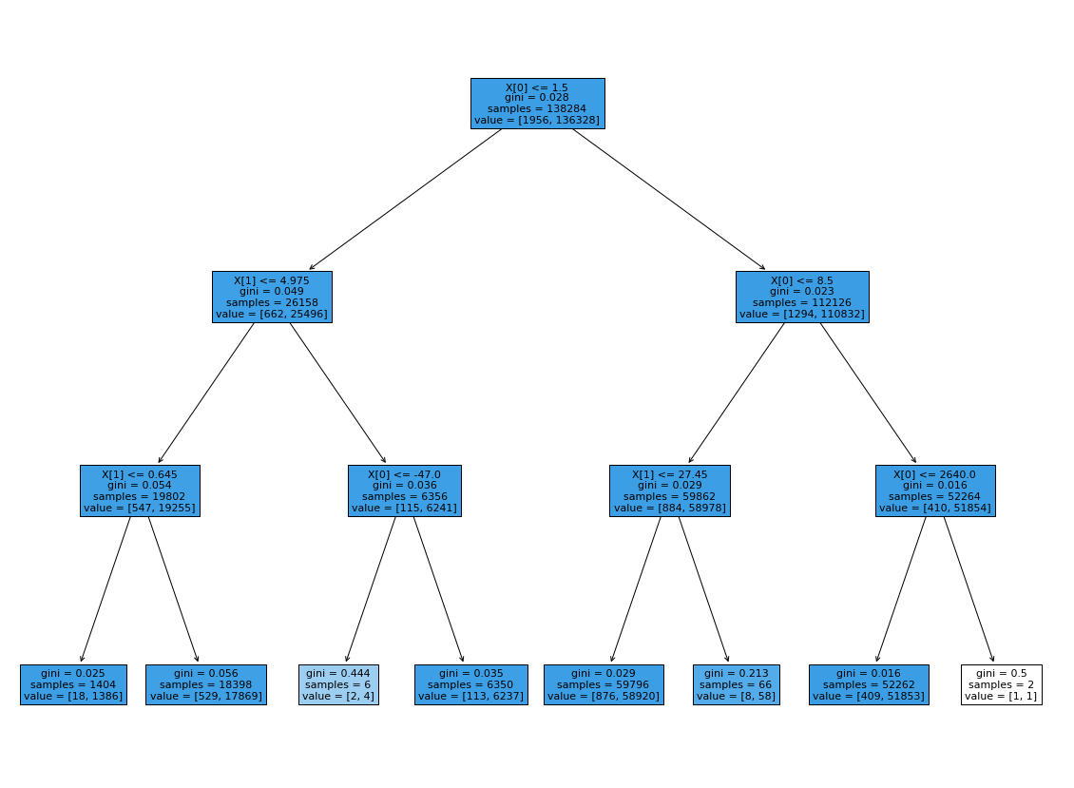
OUTPUT SCREENSHOTS
The plotting of the ID3 decision tree, representing the complete classification for only 3 levels
A MAGNIFIED VIEW

Slide 13
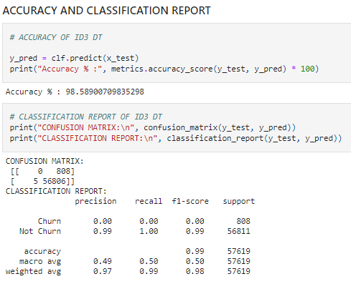
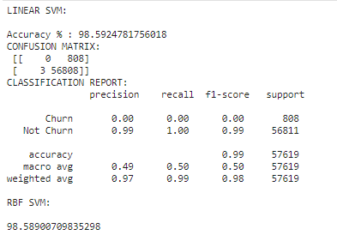
OUTPUT SCREENSHOTS
Accuracy and classification report of ID3
Accuracy and classification report of SVM

Slide 14
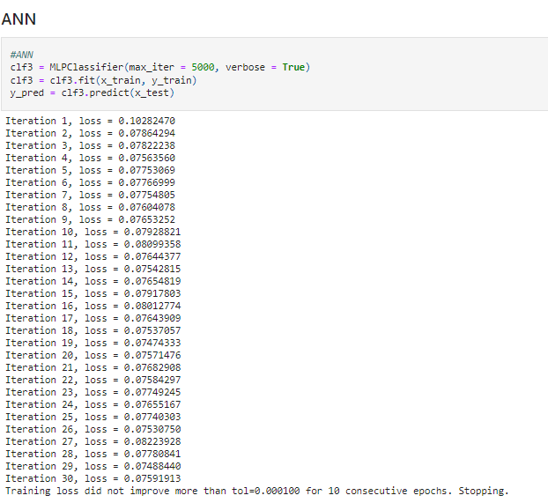
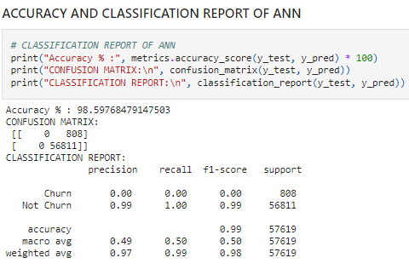
OUTPUT SCREENSHOTS
Accuracy and classification report of ANN

Slide 15
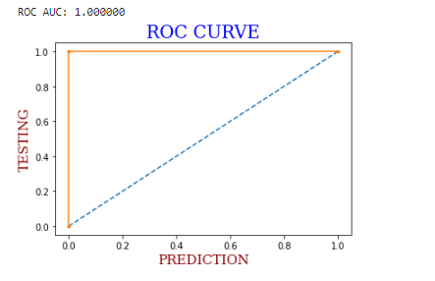

OUTPUT SCREENSHOTS
ROC : Same for all the 3 classifications

